Slide 1
Computer Architecture
Lectorial Week 3

Slide 2
Objectives
Looking at last week’s reinforcement exercises
Image representation
Creating components
Enhancing the ALU
Making links
Looking forward

Slide 3
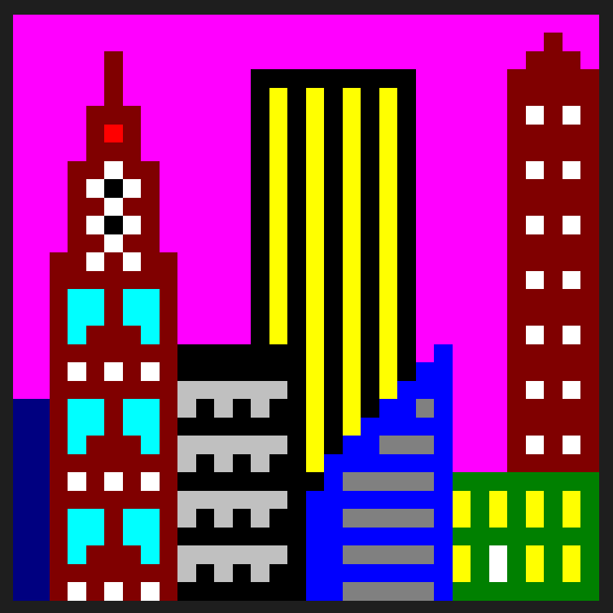
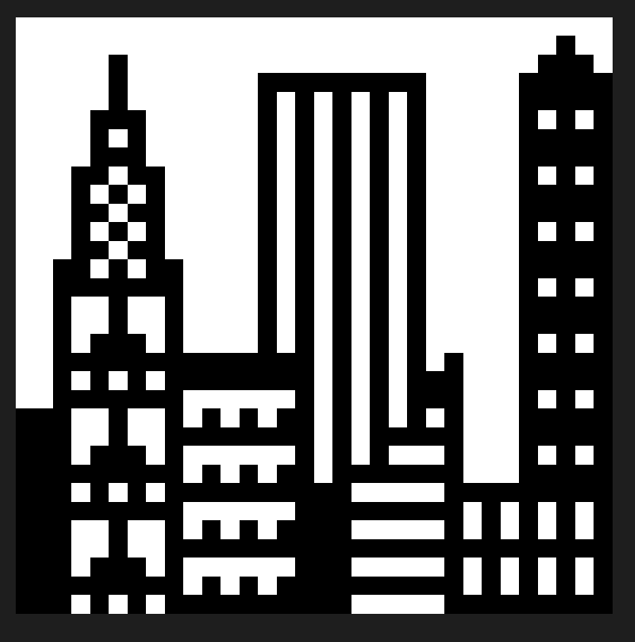
Week 1 Reinforcement Part 1
The colour depth is the number of bits used to indicate the colour of each pixel.
Investigating colour depths
4-bit colour depth
1-bit colour depth
The images on the right are in 4-bit and 1-bit colour depth respectively and are 32x32 pixels

Slide 4
Comparing file sizes
Image format | 32x32 | 8x8
24-bit | 3126B | 246B
16 colour (4 bit) | 630B | 150B
2 colour (1 bit) | 190B | 94B
Notice that the 4-bit colour depth makes a lot more difference to the file size as the image gets larger

Slide 5
1-bit colour depth
There are two colours
Each pixel has 1 bit of information (0 or 1) indicating which colour to use.

Slide 6
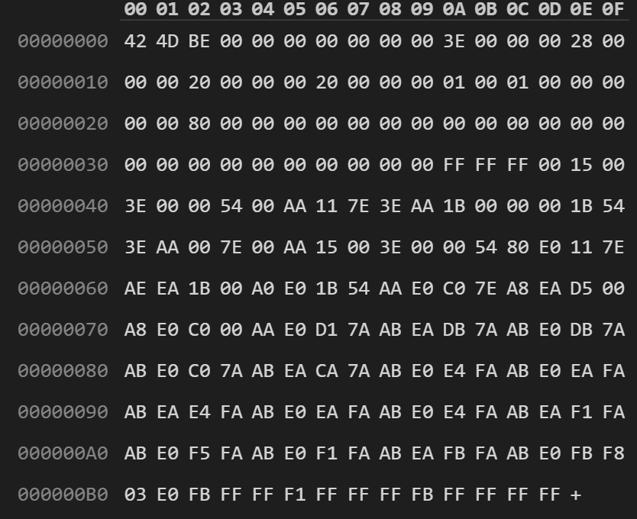
File Size
Position of start of pixel array
Looking at the bmp metadata
For the 1-bit colour depth
Number of bits per pixel
Size of the image
Start of the colour table
Each colour has 4 bytes
The first colour will be indicated by 0, the second by 1
Start of the pixel data
Pixel data for the top line of the image

Slide 7
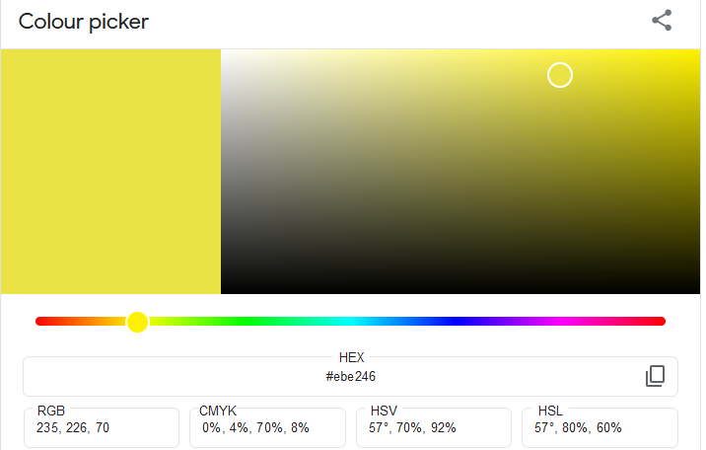
Using a colour picker
Yellow is made from red and green
RGB value FFFF00
Choosing a shade of yellow
RGB EBE246
In the bmp file format we see this as BGR

Slide 8
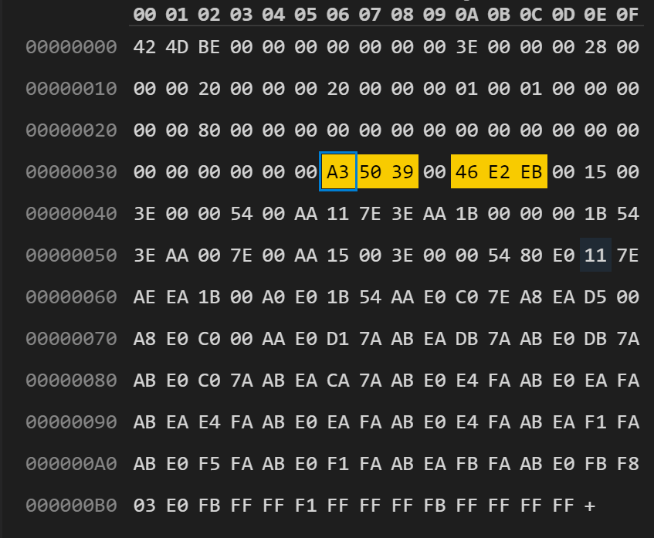
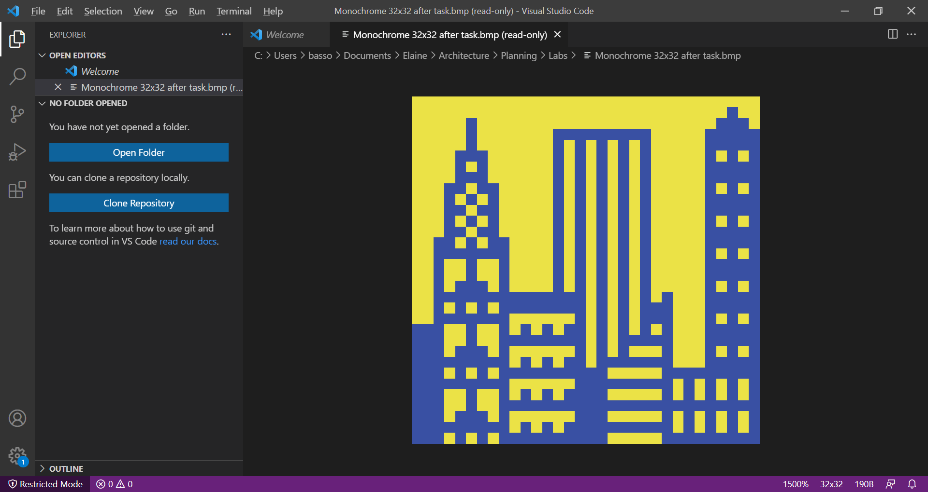
Changing the colours in the colour table

Slide 9
Changing the top line of the image
Pixel values are originally FF FF FF FF
In binary that is
1111 1111 1111 1111 1111 1111 1111 1111
One bit for each pixel so 32 bits
We want to change the pixels at the following positions from 1 to 0
6 pixels in from the left
3 pixels in from the right
In binary that is
1111 1011 1111 1111 1111 1111 1111 1011
Now we need to convert it back to hex, we can look up that 1011 is B
New pixel values FB FF FF FB

Slide 10
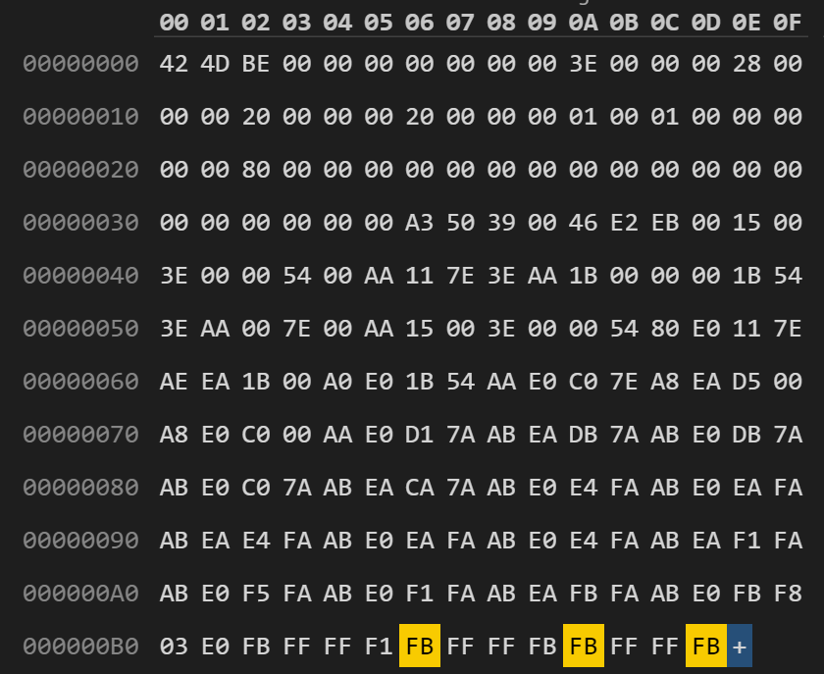
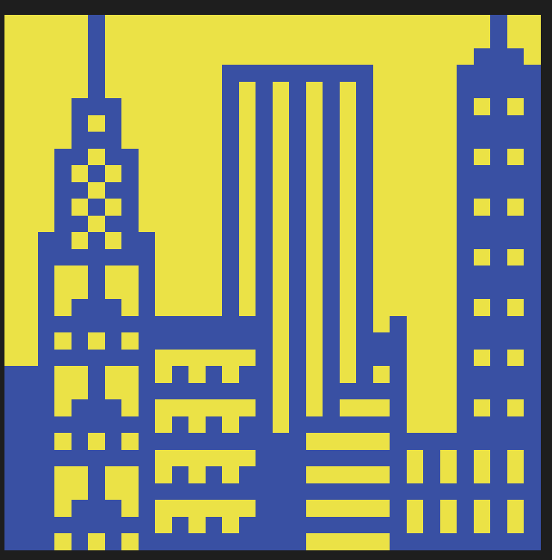
After the changes

Slide 11
16 colour image
Tasks to manipulate the colours
Now the colour table has 16 colours
Each pixel needs 4 bits to indicate its colour
Four bits is one hex digit

Slide 12
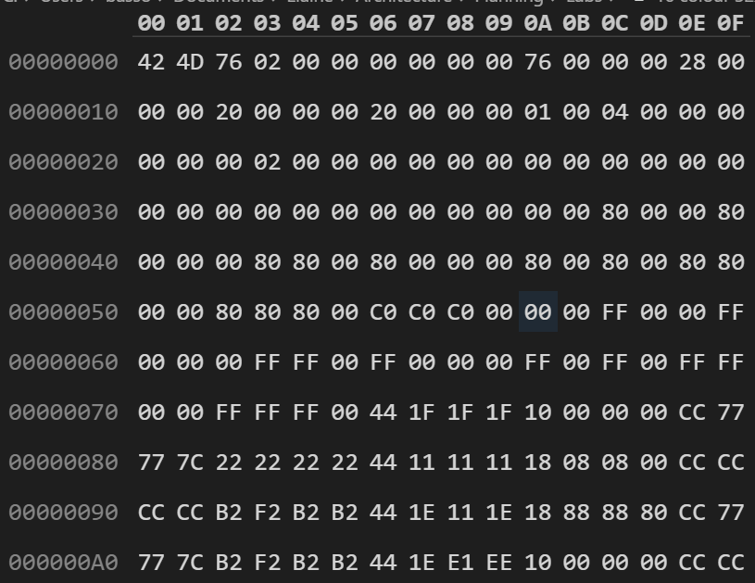
Looking at the bmp metadata
For the 4-bit colour depth
File Size
Position of start of pixel array
Number of bits per pixel
Size of the image
Start of the colour table
Note that the file size reads 76 02
This is actually hex 276
Start of the pixel data
The system is little endian, so when we are using multiple bytes for a number, the lowest order bytes come first

Slide 13
Colours in 16 colour image
Index | BGR colour | RGB colour | Colour
0 | 00 00 00 | 00 00 00
1 | 00 00 80 | 80 00 00
2 | 00 80 00 | 00 80 00
3 | 00 80 80 | 80 80 00
4 | 80 00 00 | 00 00 80
5 | 80 00 80 | 80 00 80
6 | 80 80 00 | 00 80 80
7 | 80 80 80 | 80 80 80
8 | C0 C0 C0 | C0 C0 C0
9 | 00 00 FF | FF 00 00
A | 00 FF 00 | 00 FF 00
B | 00 FF FF | FF FF 00
C | FF 00 00 | 00 00 FF
D | FF 00 FF | FF 00 FF
E | FF FF 00 | 00 FF FF
F | FF FF FF | FF FF FF

Slide 14
Changing the image
Referring to the colour table and the pixel data
Task
Change the windows that are cyan to be bright green
From colour table
Cyan was E
Bright green was A
BMP file format starts the pixel data at the bottom of the image
The first cyan pixel is on the 3rd row up and the 4th pixel from the left

Slide 15
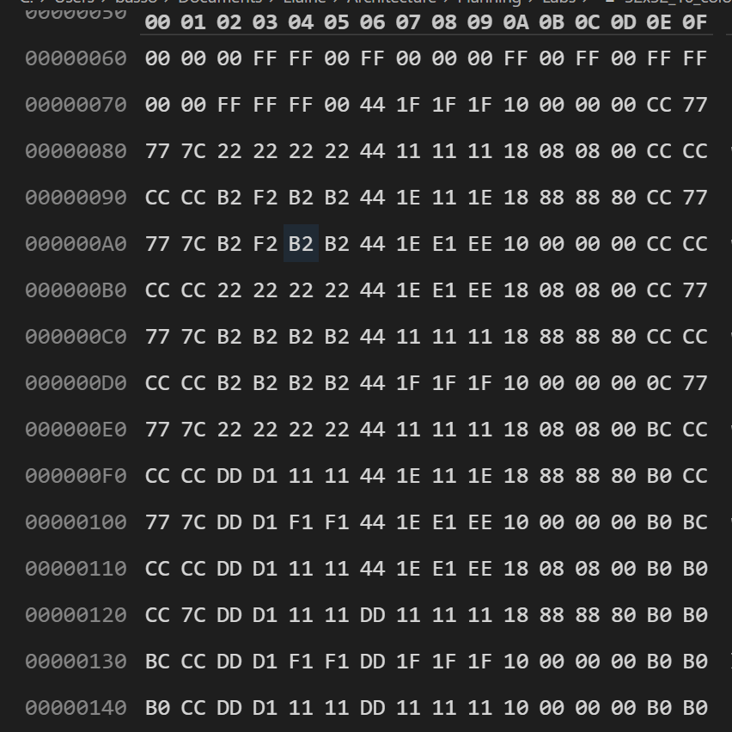
Changing the image
Start of pixel data for third row
Looking at the pixel data
Each row of pixels needs 32 hex digits – 16 bytes
The hex editor shows 16 bytes across

Slide 16
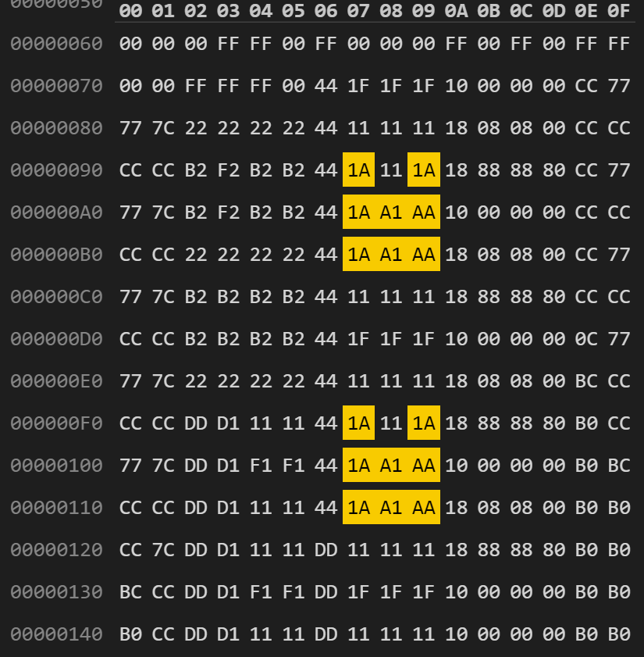
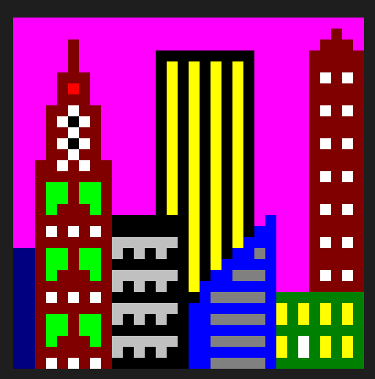
Changing the image
After changing E to A

Slide 17
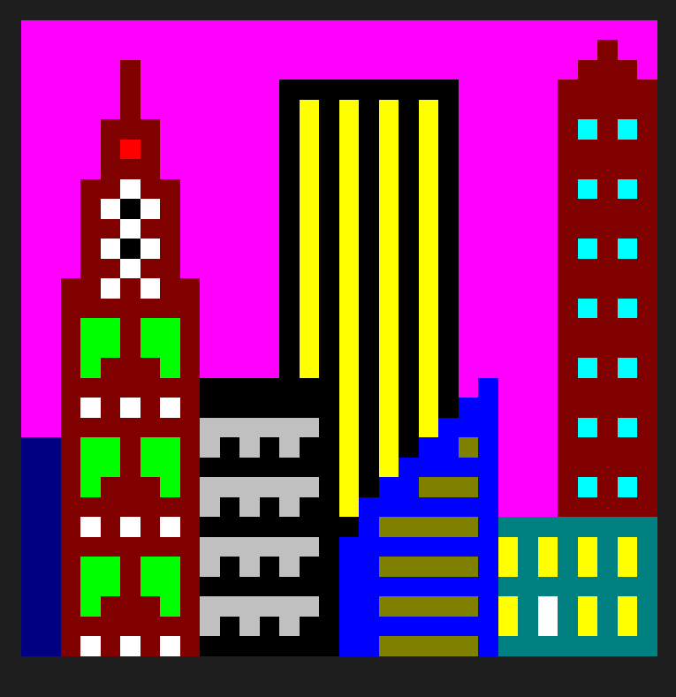
After all the changes
A similar approach was used for the other changes

Slide 18
Week 2 Reinforcement Part 2
Looking at computer components
A decoder will change a binary number to pass a signal to one (and only one) of its outputs by decoding that binary signal
A decoder that takes in a 3-bit signal can represent the decimal number 0 to 7 using those three binary digits. This decoder would need 8 different outputs (one for each number from 0 to 7).
A demultiplexer uses the ideas of a decoder
It has a binary signal that is decoded to separate outputs (select signal)
A demultiplexer passes on a data signal to the relevant output
A comparator compares two inputs

Slide 19
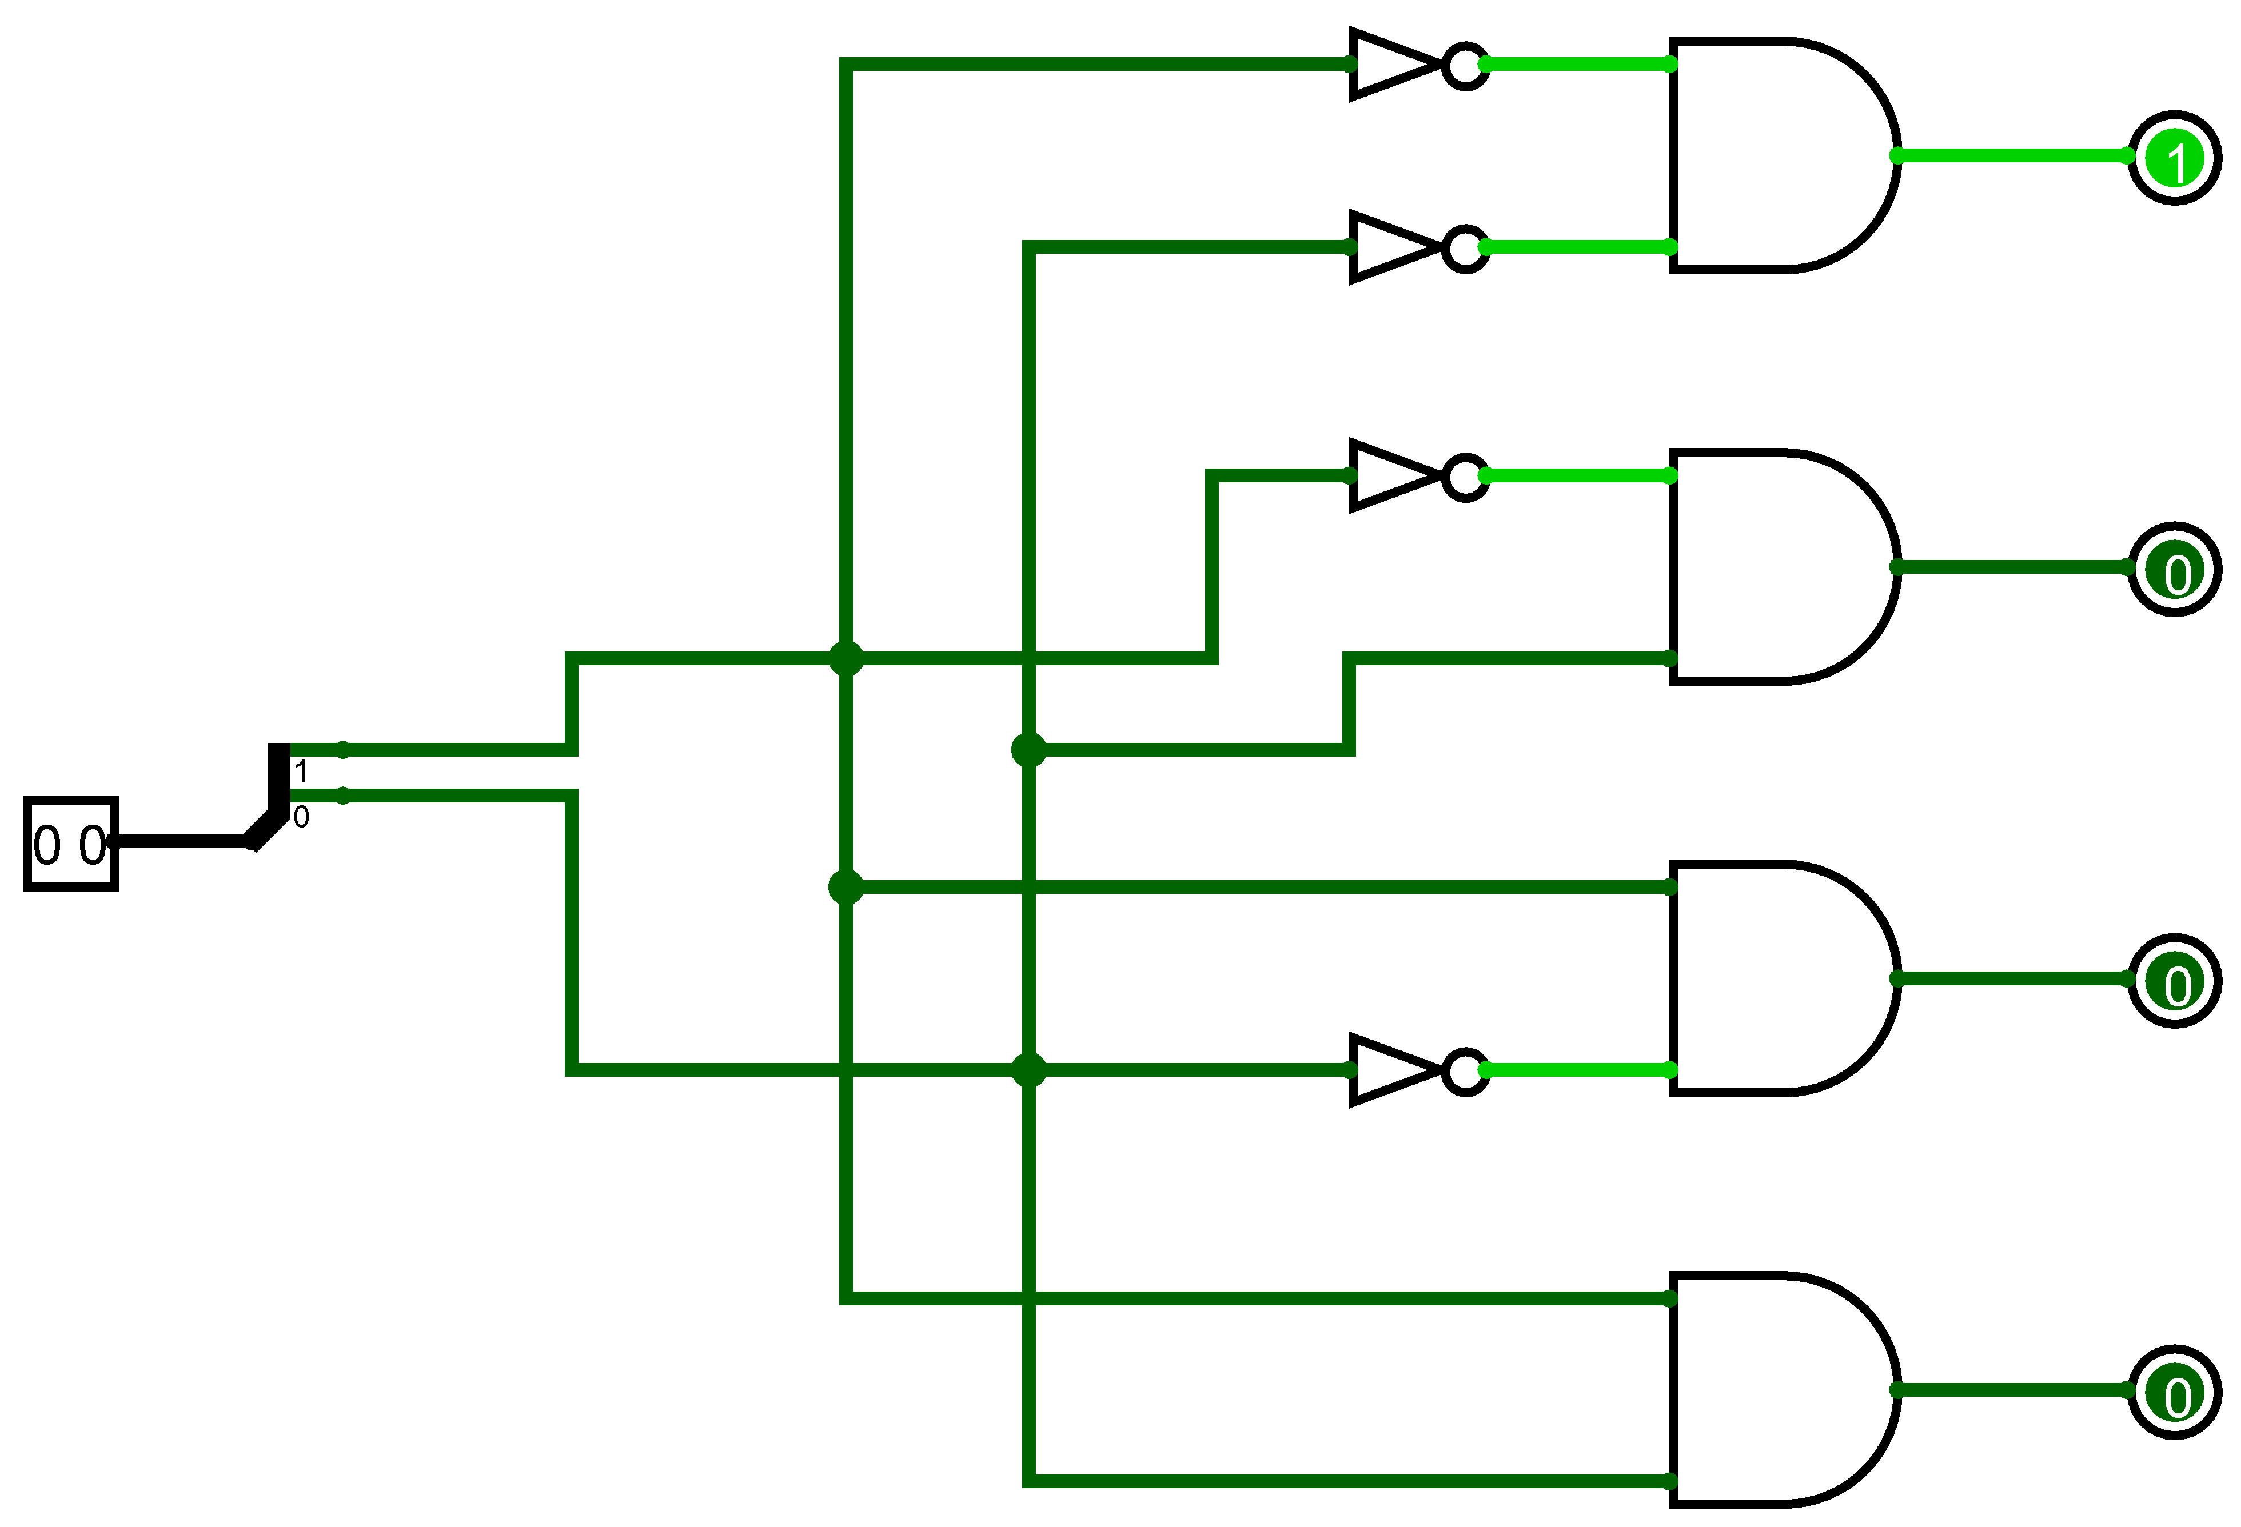
2-bit Decoder
First output is 1 when both bits of input are 0
Third output is 1 when the input is 10
Remember bit 0 is the least significant bit

Slide 20
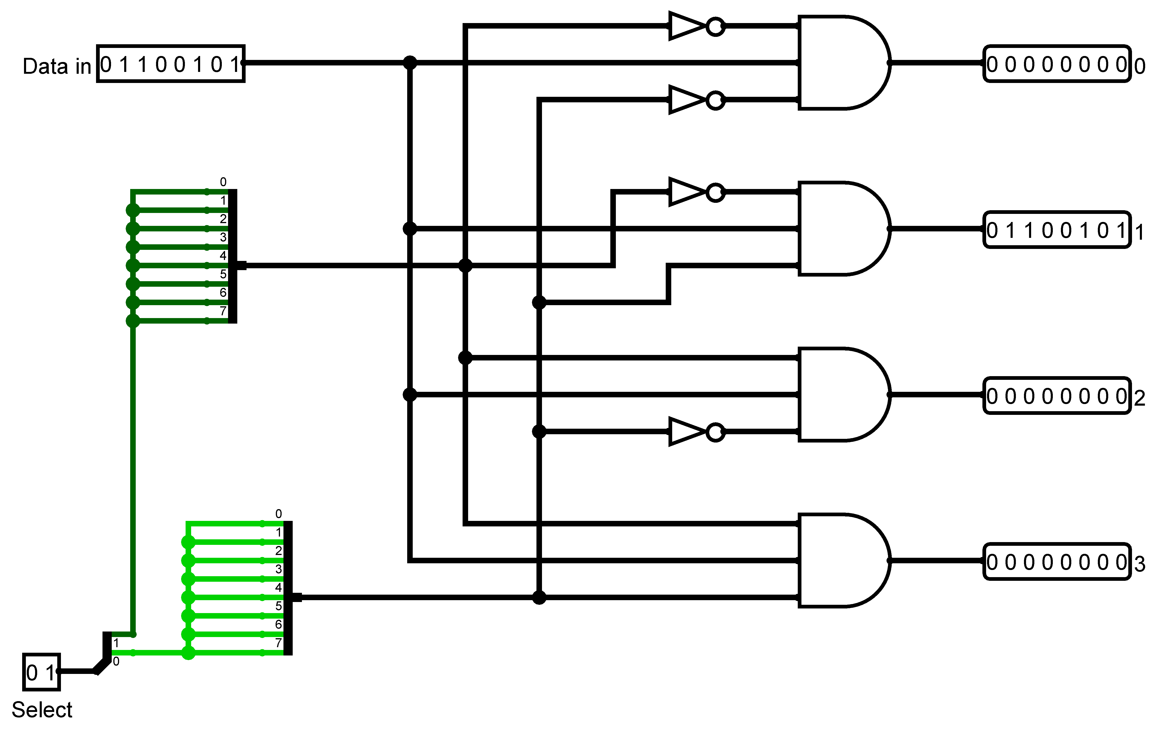
Demultiplexer
Passing an 8-bit data signal to the output indicated by the select signal
The select signal needs to be copied to 8 bits
The outputs are labelled with numbers for convenience

Slide 21
Comparing 2-bit numbers
A1 | A0 | B1 | B0 | L | E | G
0 | 0 | 0 | 0
0 | 0 | 0 | 1
0 | 0 | 1 | 0
0 | 0 | 1 | 1
0 | 1 | 0 | 0
0 | 1 | 0 | 1
0 | 1 | 1 | 0
0 | 1 | 1 | 1
1 | 0 | 0 | 0
1 | 0 | 0 | 1
1 | 0 | 1 | 0
1 | 0 | 1 | 1
1 | 1 | 0 | 0
1 | 1 | 0 | 1
1 | 1 | 1 | 0
1 | 1 | 1 | 1
1
1
Consider a comparator for 2-bit numbers
A1 and A0 represent the two bits for input A
A0 is the least significant digit
Likewise for input B
There are 16 combinations of inputs
It might be easier to consider the decimal equivalent values of 0 to 3
One of L, E and G should be set to one and the other two set to zero:
Set L as 1 if A is less than B
Set E as 1 if A and B are equal
Set G as 1 if A is greater than B
1
1
1
1
1
1
1
1
1
1
1
1
1
1

Slide 22
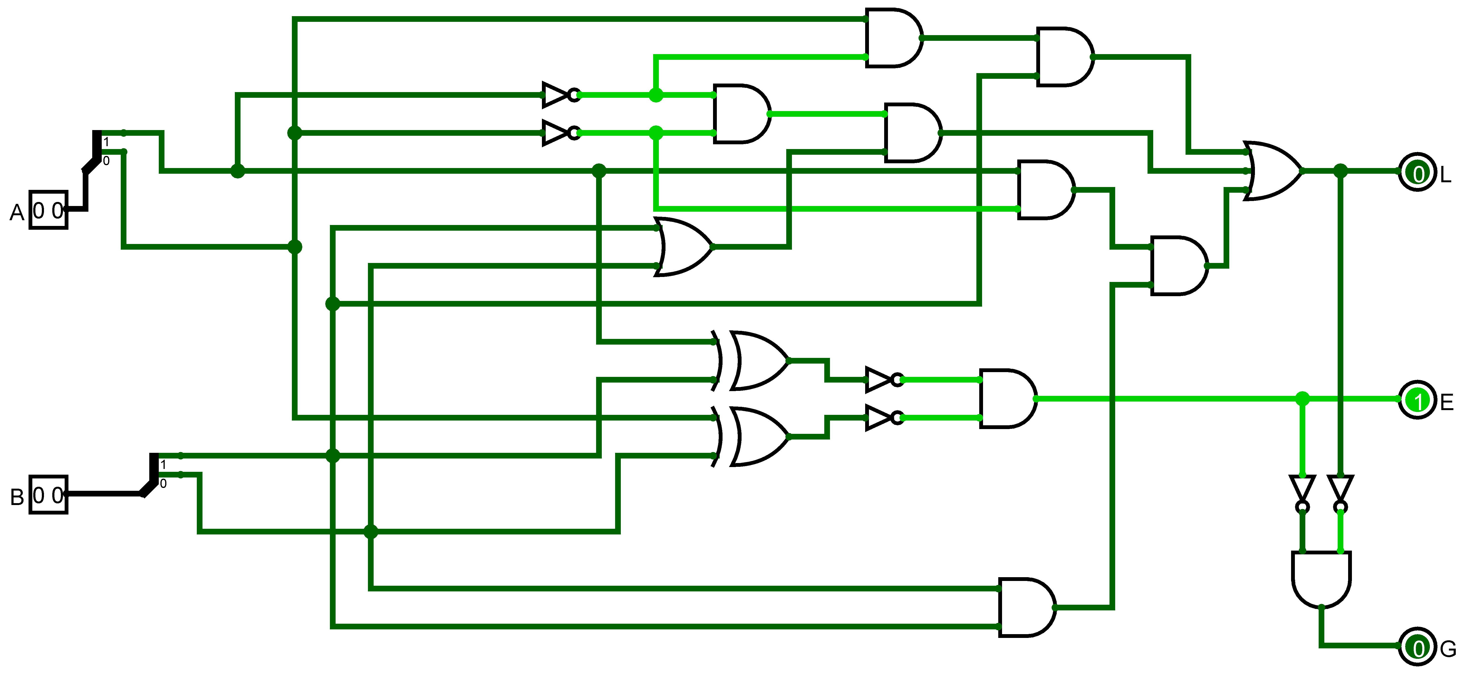
Two-bit comparator – my solution
A is less than B if A is 01 AND at the highest significance bit of B is 1
A is less than B if A is 00 AND at least one bit of B is 1
A is less than B if A is 10 AND B is 11
We had already seen a circuit for checking whether two multi-bit inputs are the same.
Note my solution for G is that when L AND E are both 0, G must be 1

Slide 23
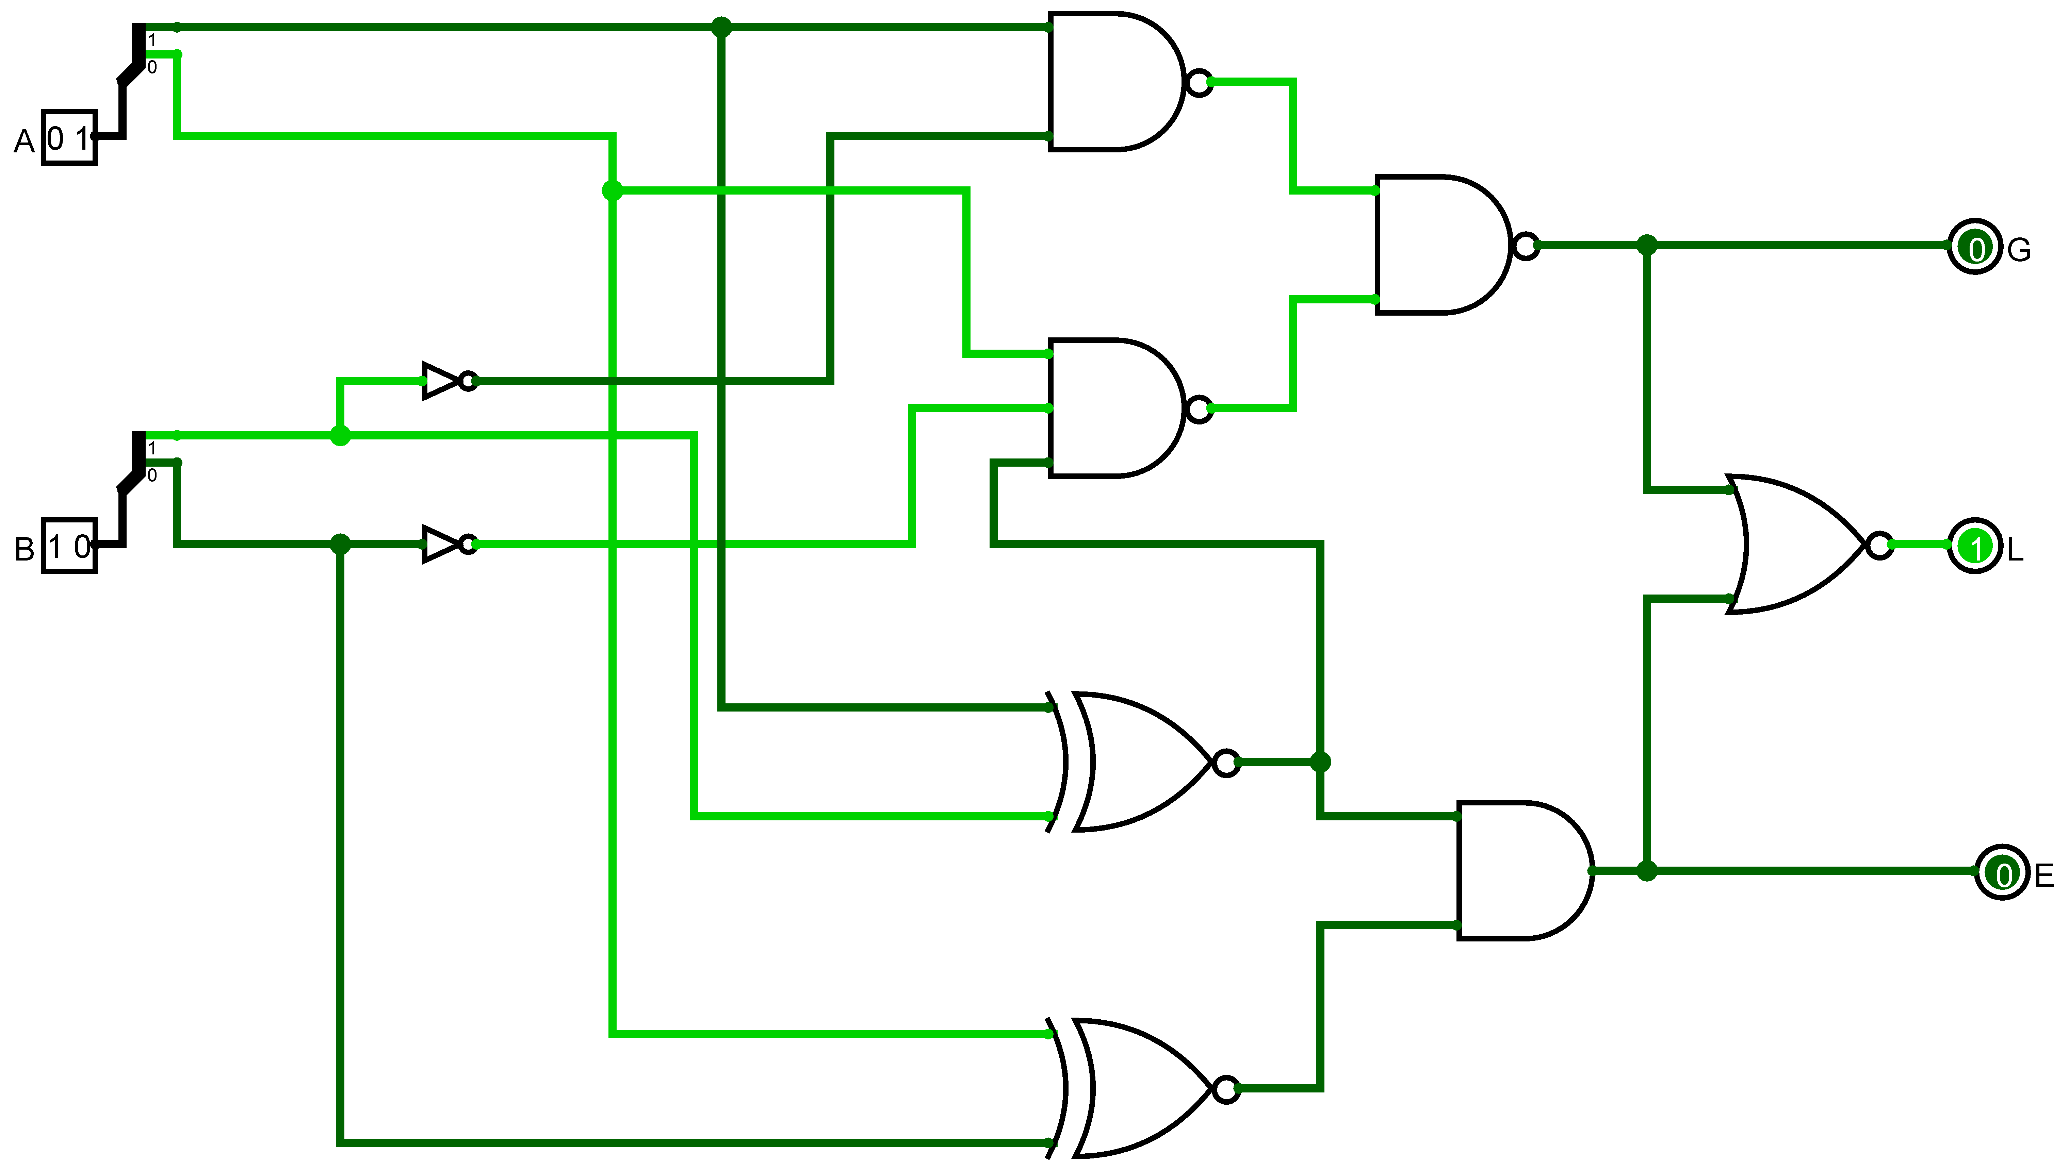
After some research
Article:
A Novel Design of Hybrid 2 Bit Magnitude Comparator
I have implemented their solution in Logisim
Notes:
International Research Journal of Engineering and Technology (IRJET) e-ISSN: 2395-0056 Volume: 06 Issue: 05 | May 2019 A Novel Design of Hybrid 2 Bit Magnitude Comparator Mahitha M. Das, Greshma Mohan, Greeshma, Aneesh K
Available from https://www.irjet.net/archives/V6/i5/IRJET-V6I51205.pdf

Slide 24
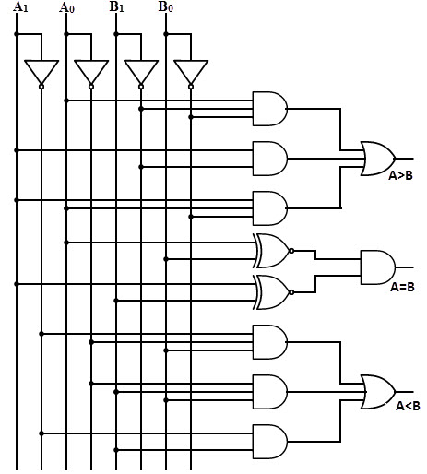
Another alternative
Note the approach to making each input and its inverse available in the circuit whilst keeping the wires tidy.
Image from: https://www.electronicshub.org/wp-content/uploads/2015/07/Two-Bit-Comparator-Logic-Diagram.jpg
Notes:
https://www.electronicshub.org/wp-content/uploads/2015/07/Two-Bit-Comparator-Logic-Diagram.jpg

Slide 25
Week 2 reinforcement Part 3
Shifting Bits
Example
8-bit binary number 00110101
Decimal (32 + 16 + 4 + 1) 53
After shifting left by 1 bit 01101010
Decimal 64 + 32 + 8 + 2 106
Shifting original right by one bit 00011010
Decimal 16 + 8 + 2 26
Moving to the left has multiplied by 2
Moving to the right has divided by 2 (and lost the remainder)

Slide 26
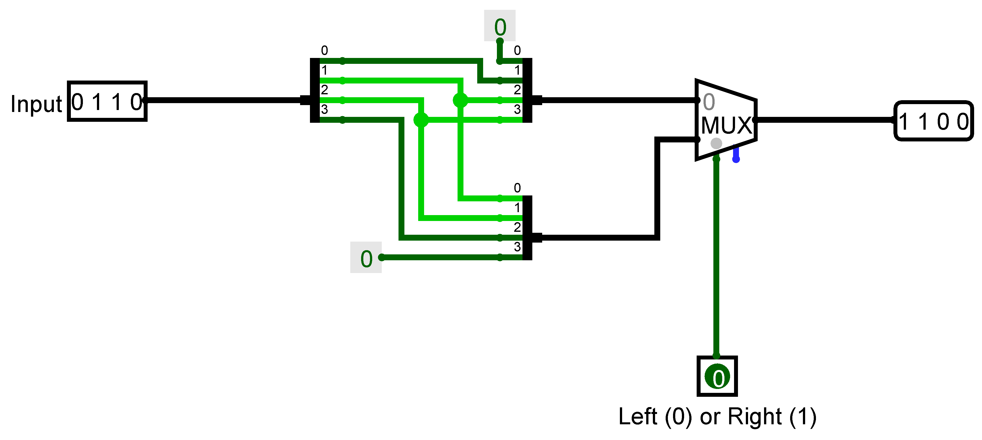
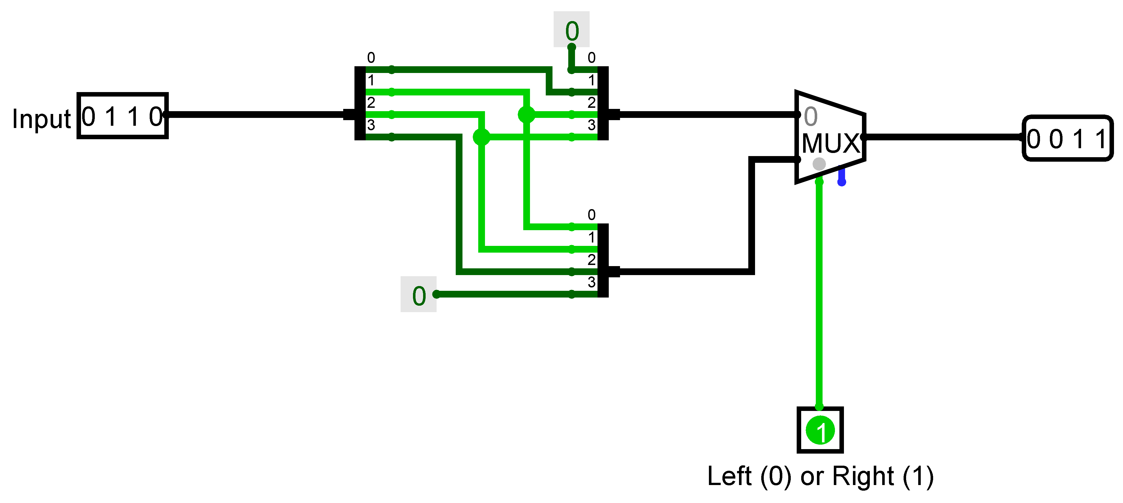
Building a bit shifter
Version that shifts by 1 bit left or right

Slide 27
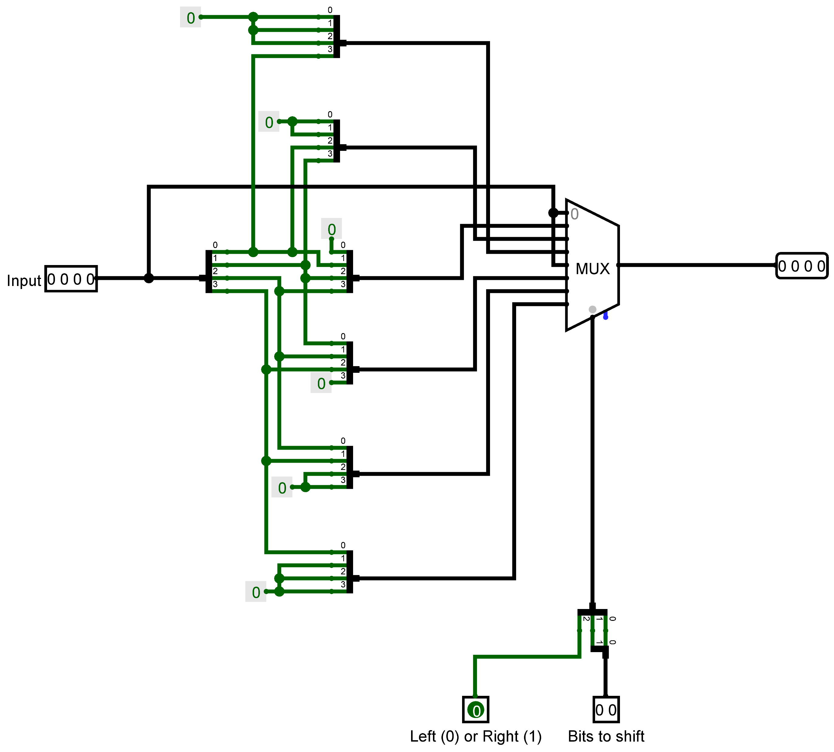
Creating a flexible bit shift
This does all the shifts in parallel
Uses a multiplexer to select the output required
The input is unchanged when bits to shift is 0

Slide 28
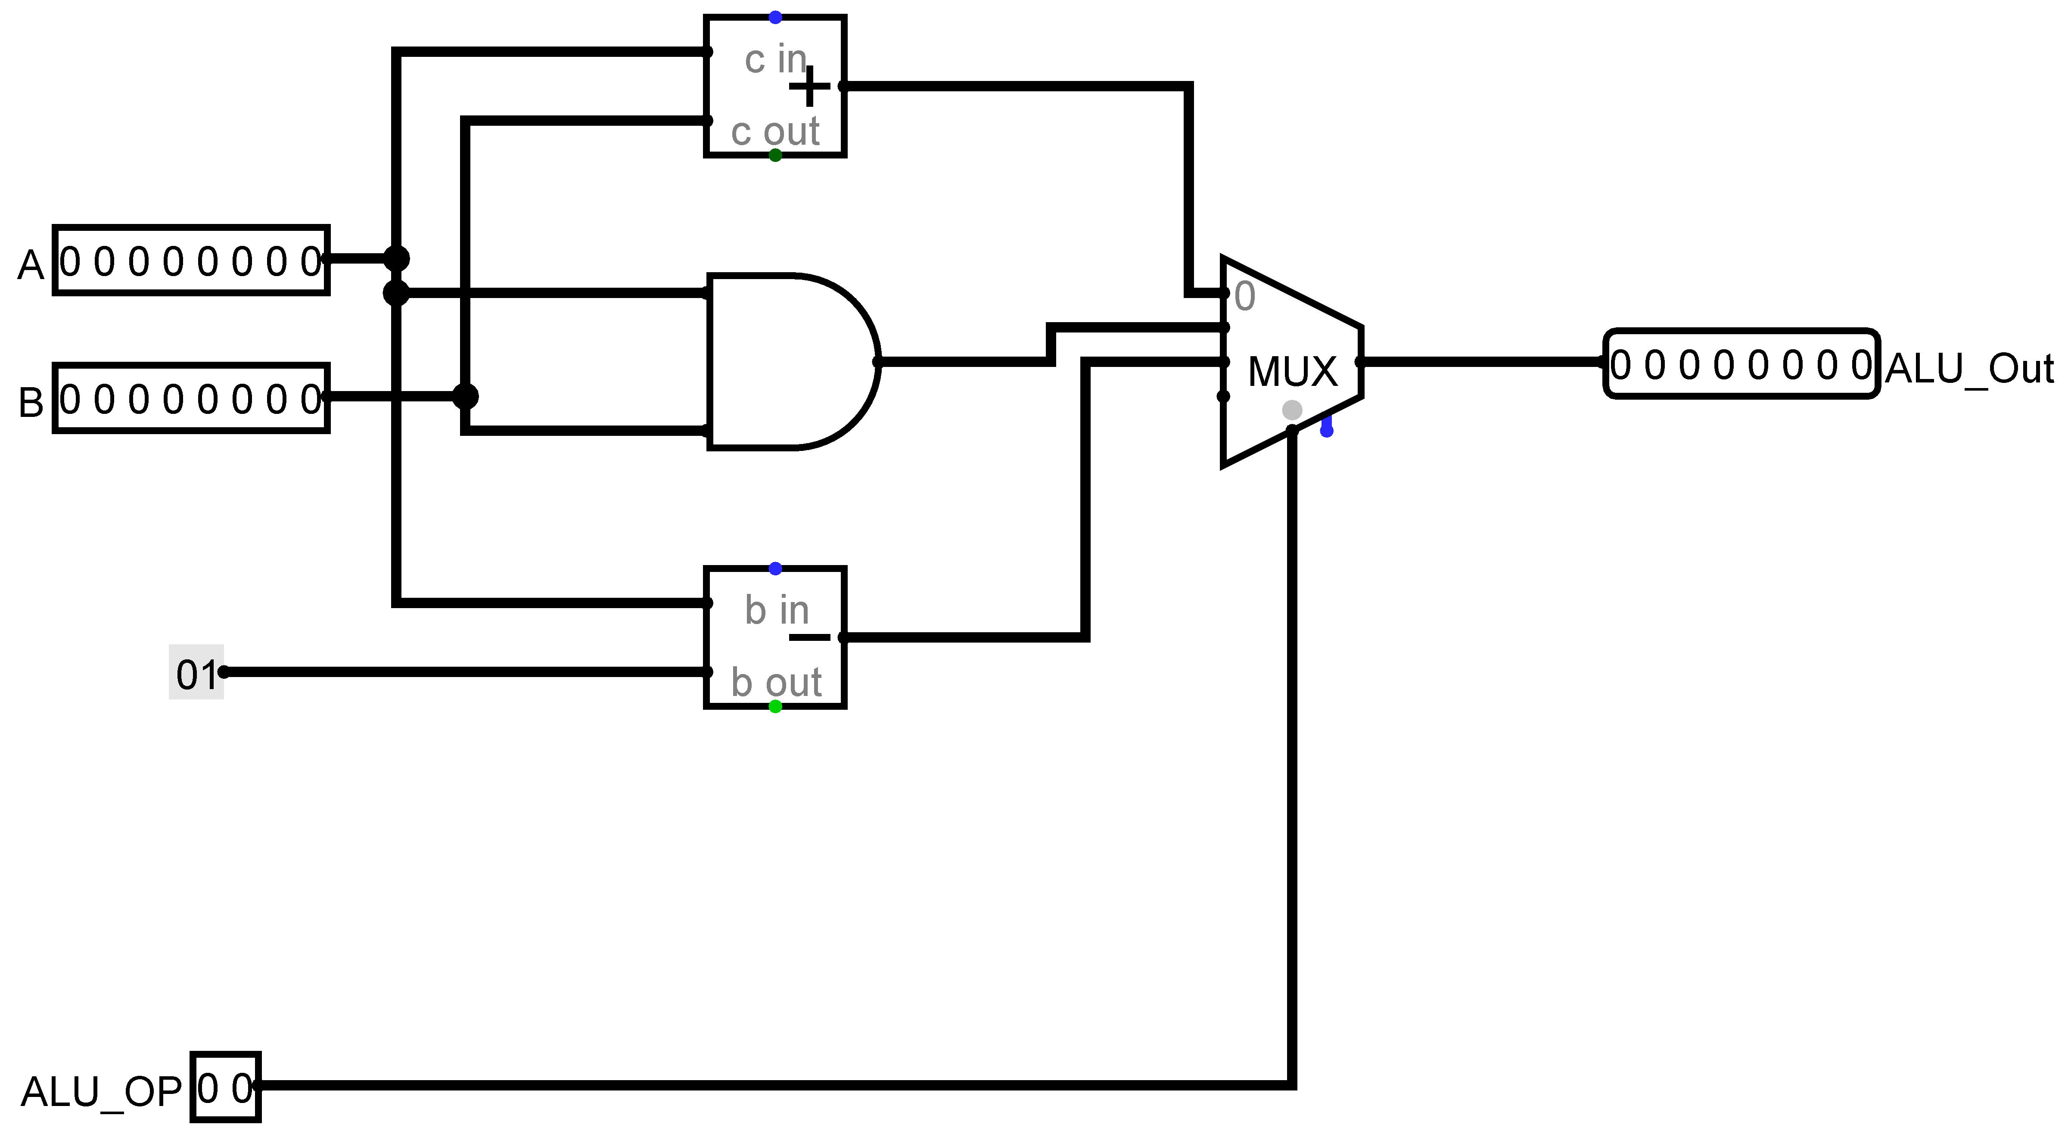
ALU from lab session
There are two 8-bit inputs A and B that need to have an operation carried out
The operations will all be carried out in parallel
There is an addition input, ALU_OP that indicates which operation to select to send to the output

Slide 29
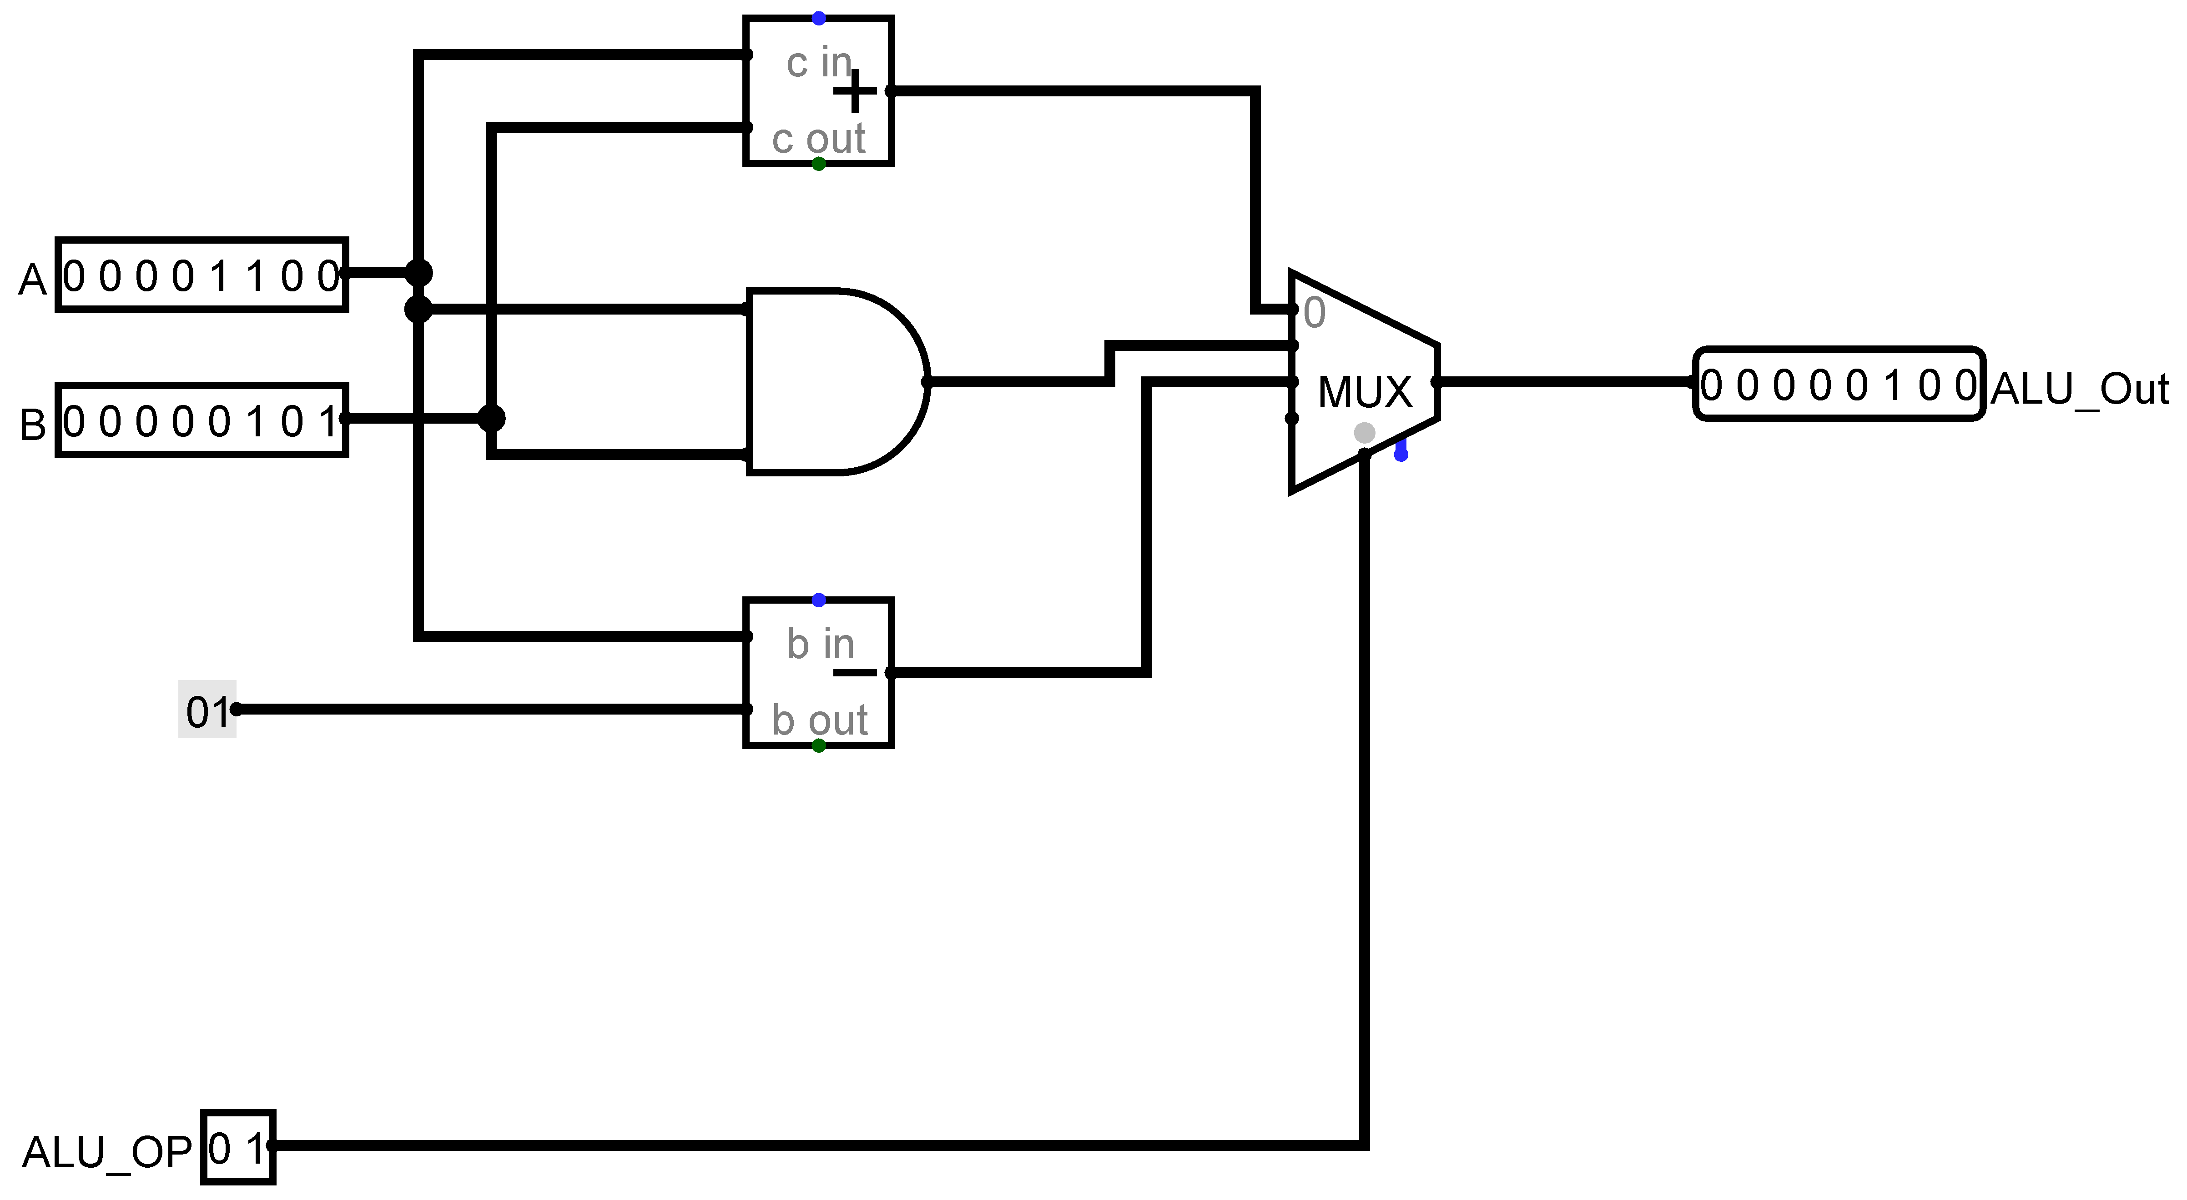

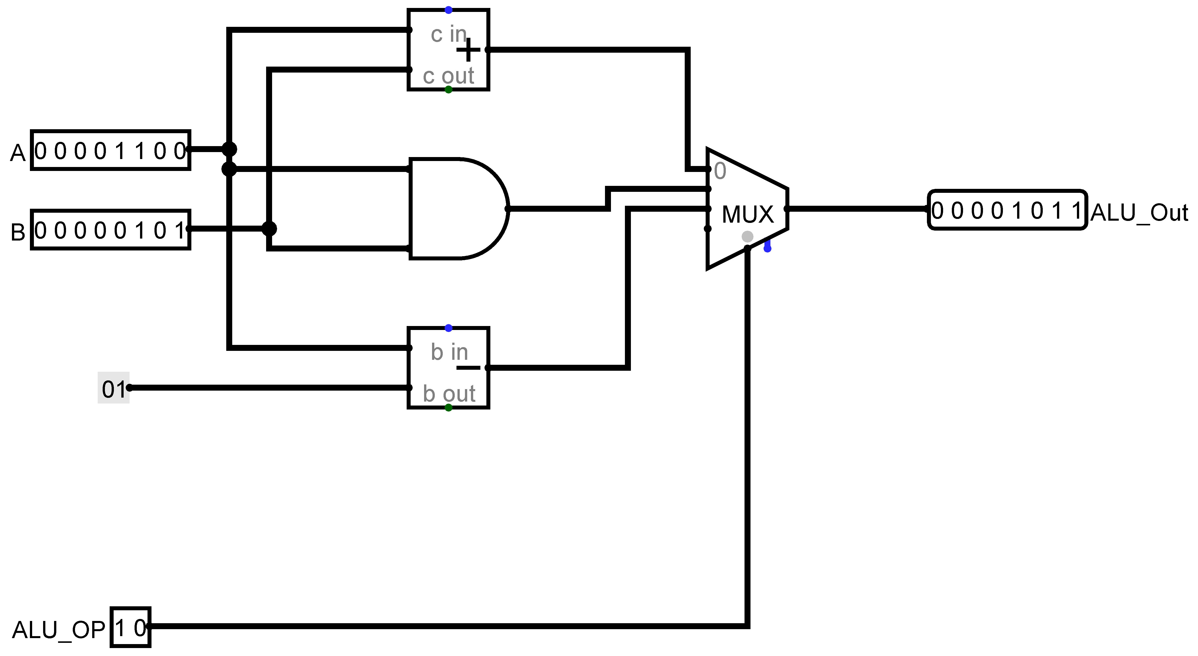
Testing the ALU from the lab session

Slide 30
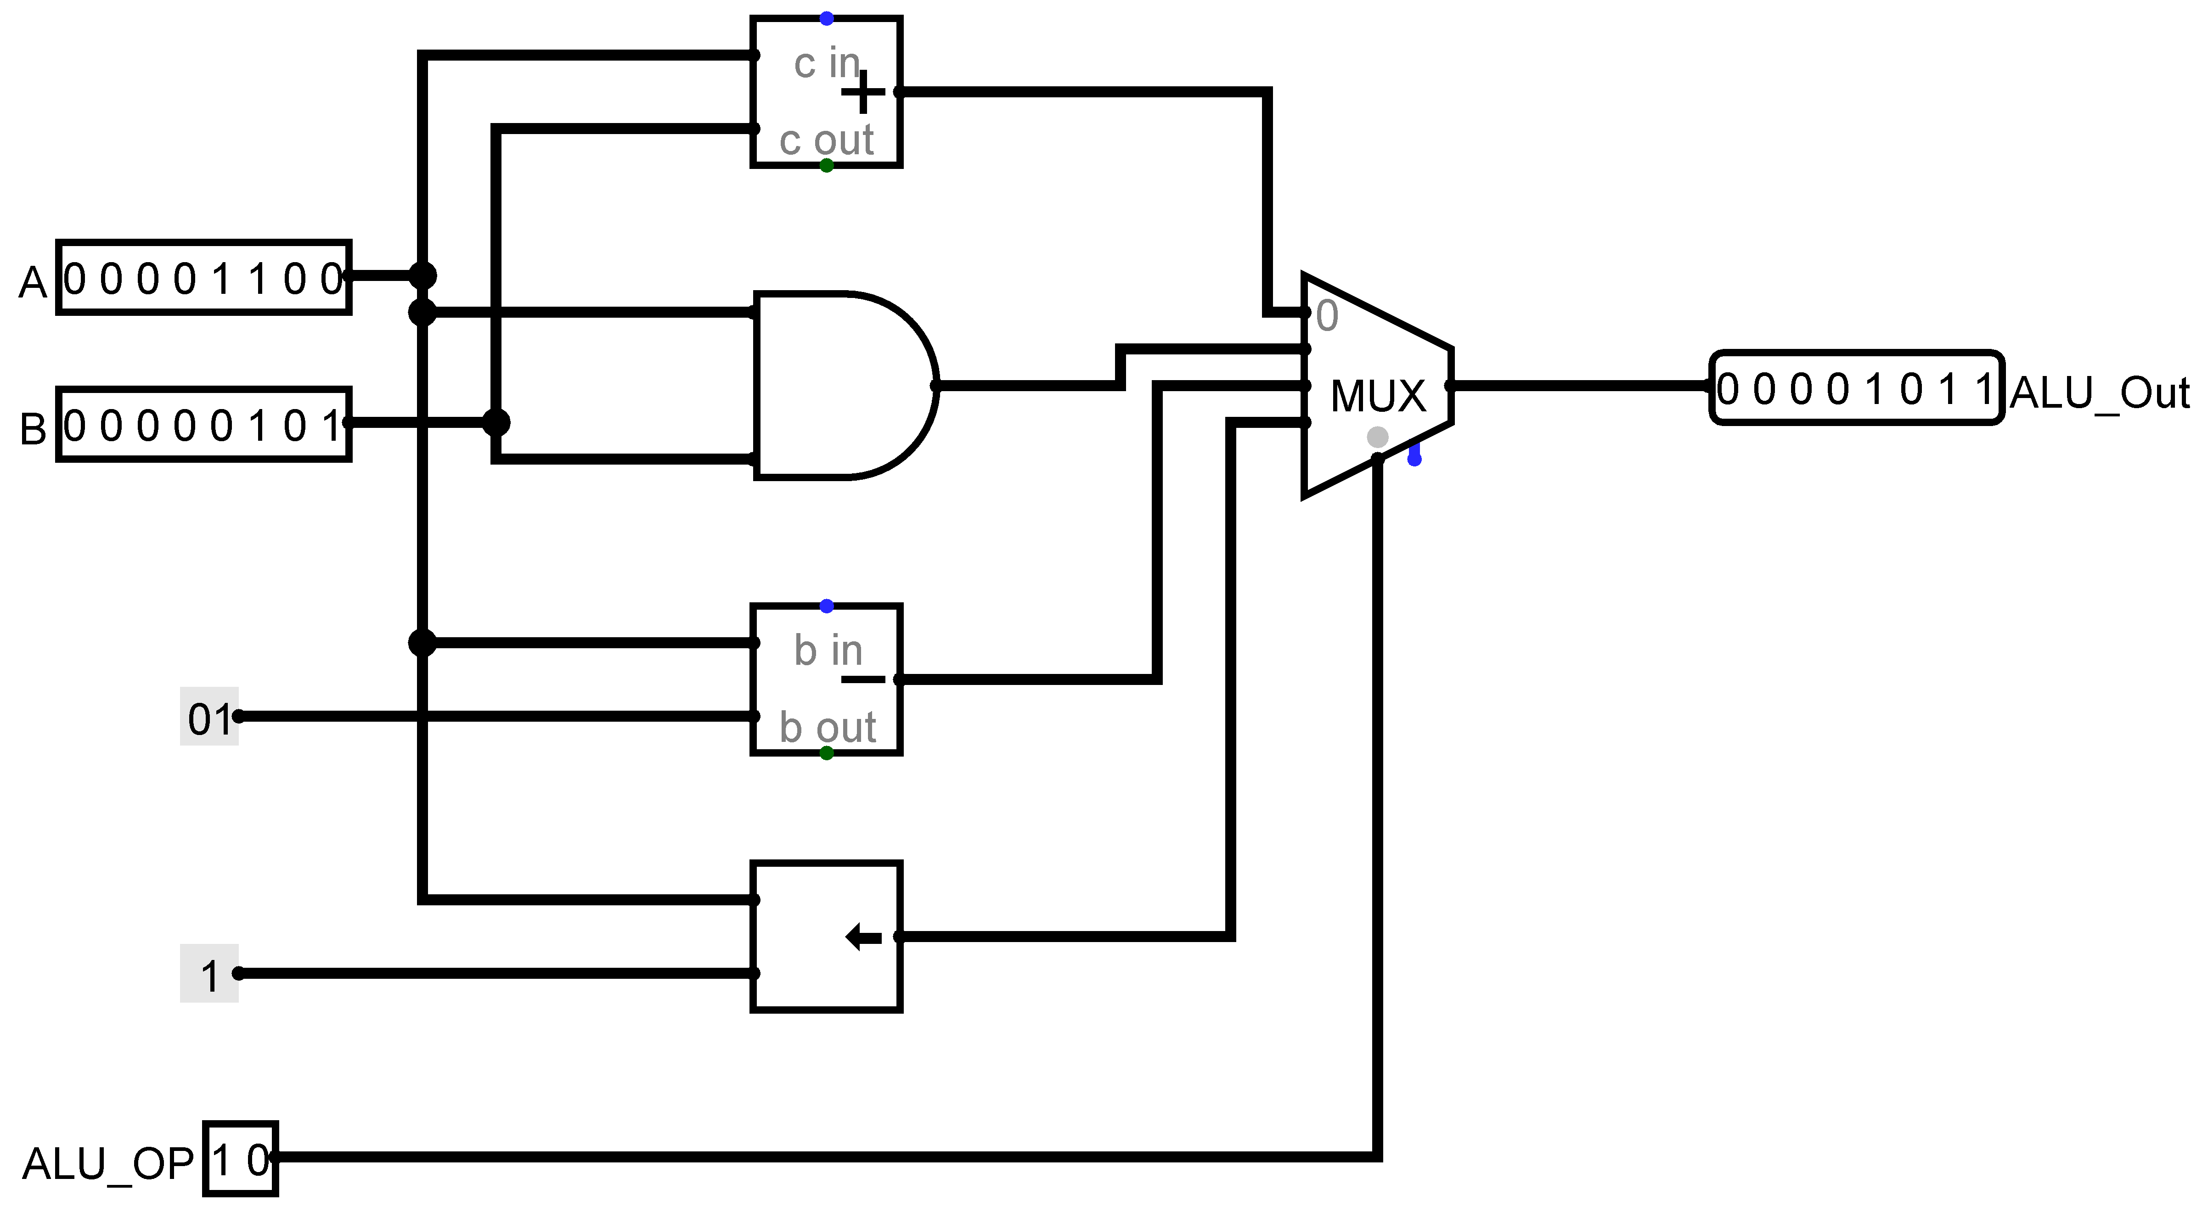
Amending the ALU
Operation 3 is result of:
Shifting the bits in A left by 1-bit so that the rightmost bit will be filled with a zero.
From Logisim library reference
Second input to shifter is:
The number of bits by which to shift the data input … if Data Bits were 8, this input would require 3 bits.
I have used a constant (from the wiring tools) with 3 bits and a value of 1

Slide 31

Testing the amended ALU
To test this properly you would do regression testing
That is test that all the previous features still work
This shows the test for the left shift only

Slide 32
Making links – Java primitive data types
byte: 8-bit signed two's complement integer. Range -128 to 127.
short: 16-bit signed two's complement integer. Range -32,768 to 32,767.
You can use a short or byte to save memory in large arrays, in situations where the memory savings matter.
int: 32-bit signed two's complement integer (by default). Range -2,147,483,648 to 2,147,483,647
long: The long data type is a 64-bit two's complement integer.
char: The char data type is a single 16-bit Unicode character. It has a minimum value of '\u0000' (or 0) and a maximum value of '\uffff' (or 65,535 inclusive)
Notes:
Adapted from https://docs.oracle.com/javase/tutorial/java/nutsandbolts/datatypes.html

Slide 33
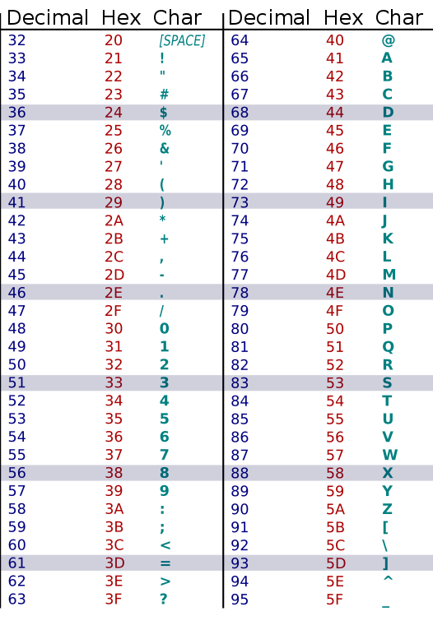
Using a char
char num1 = 68;
for (int i = 0; i < 6; i++)
{
System.out.println(num1);
num1++;
}
num1 = 0x37;
for (int i = 0; i < 6; i++)
{
System.out.println(num1);
num1++;
}
num1 = 'v';
for (int i = 0; i < 6; i++)
{
System.out.println(num1);
num1++;
}
D
E
F
G
H
I
7
8
9
:
;
<
v
w
x
y
z
{

Slide 34
Using a byte and a short
124
125
126
127
-128
-127
-126
-125
32765
32766
32767
-32768
-32767
-32766
-32765
-32764
byte num2 = 124;
for (int i = 0; i < 8; i++)
{
System.out.println(num2);
num2++;
}
short num3 = 32765;
for (int i = 0; i < 8; i++)
{
System.out.println(num3);
num3++;
}

Slide 35
Looking forward
Week 3 lab sessions look at how to store values over time
Registers and memory
This will be vital for simulating a working (simplistic) computer

